Slide 1
Ready, Set, Goal!
3 Types of Goal Setting Strategies.
Which one is right for you?

Slide 2
Who am I?
Certified Career Coach
Résumé Writer ~ Interview Prep Coach ~ LinkedIn Strategist ~ Author ~ Speaker
Corporate America – since 1999, 18+ in leadership
Married for 25 years
Mother to a college sophomore named Nadia MyAngel
Maw-maw to a Shi-poo named BamBam
I love scrapbooking and guacamole and chips………☺

Slide 3
Overview & Purpose
There are several types of goal setting
We will discuss three
Visioning
Personal Development Plan
12 Week Year
Choose one that fits your personality

Slide 4
Stick to it!

Slide 5
Goal Setting Method - 1
Specific and Measurable
Stated Positively
Realistic Stretch
Time Bound

Slide 6
Goal Setting Method - 2
S.M.A.R.T. Method
Specific
Measurable
Action Oriented
Relevant
Time Sensitive

Slide 7
So What Are You Going To Do?
A goal without a plan is
just a wish.

Slide 8
Let’s Do This!

Slide 9
Visioning
Businessdictionary.com
Begin with the End in mind
Let’s get Visual
Mental process in which images of the desired future (goals, objectives, outcomes) are made intensely real and compelling to act as motivators for the present action.
This process allows you to see what it is you want to accomplish.
Get a board, a journal, or use a digital app.
Select photos, sayings, and other artistic symbols that articulate what you want.
Keep it in a place where your can see it.

Slide 10
Personal Development Plan
What is a
Personal Development Plan?

Slide 11
A personal development plan is a continuous
lifelong process of nurturing, shaping, and
improving skills and knowledge to
maximize your effectiveness in
___________ (you fill in the blank).

Slide 12
Personal Development Plan
So how do
you create
a PMP?

Slide 13
PMP – Part 1
Establish aims, objectives, or goals.
What do you want to achieve?
Where do you want to go?
How long in the short, medium or long-term?
Truth time - Assess your current realities
Identify skills, knowledge or competencies you need to acquire
Select the appropriate development activities to close the gap

Slide 14
PMP – Part 2
Set a timeline to accomplish your goals.
Do you think you can do it in 30? 60? 90, 180, or 365 days?
The bigger the goal, the longer the time line.
Timeline - Place the activities on the timeline. Set a mid-point / check-in date.
Last, set an end date.
Ask - What success will look like once I achieve my goal?

Slide 15
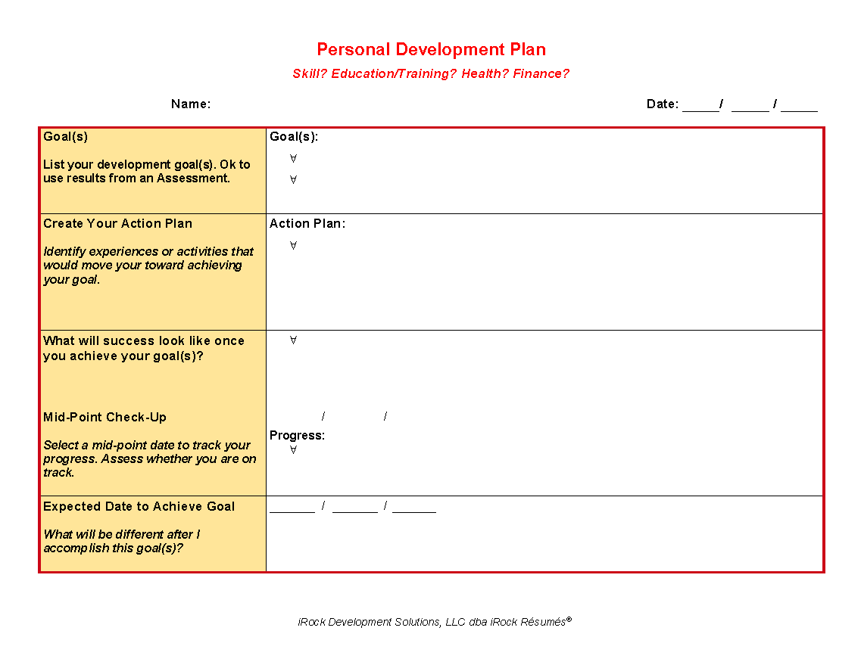
If you want a copy of this, send an email to:
irock@irockresumes.com
Put ”PDP” in the
subject line

Slide 16
The 12 Week Year Method

Slide 17
The Premise Behind the 12-Week Year Method
Shift thinking from yearly goals with 52 weeks to 12 weeks
Can begin at anytime
Not based on quarterly

Slide 18
The Premise Behind the 12-Week Year Method
Make a statement of what it will take to live your vision
Use the statement to create goals
For each goal, list the tactics that will help you reach the goal
Add a due date to each goal

Slide 19
Your vision is the
“what”.
The 12 week plan is the
“how”.

Slide 20
The Premise Behind the 12-Week Year Method
Make a statement of what it will take to live your vision
Use the statement to create goals
For each goal, list the tactics that will help you reach the goal
Add a due date to each goal

Slide 21
In Conclusion…

Slide 22
A goal properly set, is halfway reached.
- Zig Ziglar

Slide 23
Books I Highly Recommend

Slide 24
Questions?

Slide 25
Let’s Stay Connected!
LinkedIn – Nickquolette Barrett
Like & Follow iRock Résumés on
Instagram/Pinterest/Twitter @irockrésumés
www.irockresumes.com to sign up for my mailing list

Slide 26
I love testimonials!
Please leave a recommendation
on my LinkedIn page or
a review or on my FB page.
And by all means, tell others!!

